Slide 1
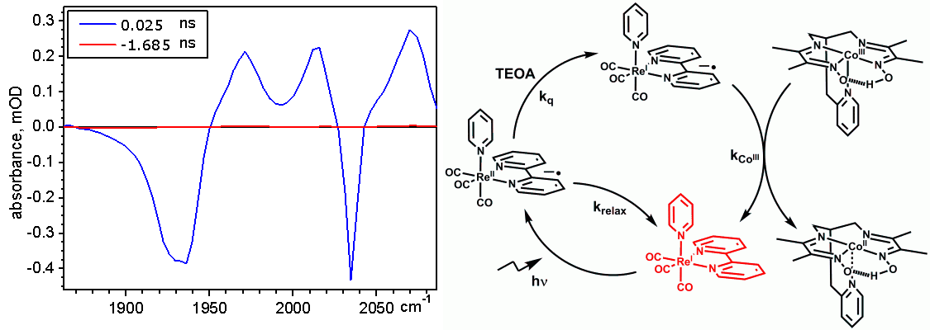
Reaction Mechanisms CHE 323
Christina Nevado, Roger Alberto FS 2018
k_{obs} = (k₁k₂[CN–] + k_{–1}k_{–2})/(k_{–1} + k₂[CN–])

Slide 2
Table of Content
Introduction
1.1 Some Basic Concepts
Elementary Reaction (Steps)
Reaction Orders
Activation Energy
Rate Profiles
….
2. Rate Laws and Mechanisms
2.1 Simple Kinetic Rate Laws
2.2 Consecutive Reactions
2.3 Reversible and Concurrent Reactions
3. Overall Reaction and Reaction Rate
3.1 Steady state Approximation
3.2 Prior Equilibrium Kinetics
3.3 Catalysis and Enzyme Catalyzed Reactions
3.4 Competitive Inhibitors
4. Deduction of Mechanisms
4.1 pH Dependencies
4.2 The Transition State Theory
4.3 Microscopic Reversibility
4.4 Solvents and Super Acids
4.5 Diffusion Controlled Reactions
4.6 Kinetic Isotope Effect
5. Linear Free Energy Relationships
5.1 Hammett (Brown, Taft) Correlation
5.2 Ligand Field Stabilization Energies
5.3 Trans Effect / Trans Influence
Electron Transfer reactions
6.1 Outer – and Inner Sphere e⁻-Transfer
6.2 Rate Laws for e⁻-Transfer Reactions
6.3 Encounter Complex – e⁻-Transfer Step
6.4 Marcus-Hush Correlation
6. Photochemical Reactivity
6.1 Excited Molecules
6.2 Photochemical Kinetics
6.3 Photocatalysis

Slide 3
Literature
James H. Espenson
Chemical Kinetics and Reaction Mechanisms, McGraw Hill 2002 or newer
M.L. Tobe, J. Burgess
Inorganic Reaction Mechanisms, Addison Wesley Longman, Essex UK, 2000
Robert B. Jordan
Reaction Mechanisms of Inorganic and Organometallic
Systems, Oxford University Press, 2007 (Third Edition)
Jim D. Atwood
Inorganic and Organometallic Reaction Mechanisms, VCH,
1997 (Second Edition)

Slide 4
Motivation
Why do we want to know a reaction mechanism ?
What can we do to deduce a mechanism ?
A few examples or "How does it work ?"
dissociative – associative – pH (in(dependent) X- dependent ?
does it matter at all ?
CO insertion or methyl migration
or does it matter at all ?

Slide 5
Motivation
Why do we want to know a reaction mechanism ?
What can we do to deduce a mechanism ?
HCOOH
H₂ / CO₂
HCOOH
H₂ / CO₂: The more the better ?

Slide 6
Motivation
Why do we want to know a reaction mechanism ?
What can we do to deduce a mechanism ?
A few examples or "How does it work ?"
R
S
will addition of PR₃ accelerate or decelerate racemisation?
is an S_{N1} reaction always 1st order in R-LG ?
why does Photosynthesis work with 10% sunlight at its maximum speed ?
are there reactions which become slower with increasing temperature?

Slide 7
Motivation
The only way to understand and confirm a reaction mechanism is through
deduction of its rate and the influence the different parameters have on it
rate = k⋅[A]
the rate "constant" k in an overall reaction is often not constant, but
Comprises the information needed to understand a mechanism
It is easy to draw a mechanism but it is difficult to prove it
+ olefin
- phosphine
- phosphine
+ olefin
which of the two … and does it matter?

Slide 8
Motivation
A study into the kinetics of a chemical reaction is usually carried out with one or both of two main goals in mind:
1. Analysis of the sequence of elementary steps giving rise to the overall reaction. i.e. the reaction mechanism.
2. Determination of the absolute rate of the reaction and/or its individual elementary steps.
The aim of the 1st part is to show you how these two goals may be achieved

Slide 9
1.1 Some Basic Concepts
Reaction Mechanism
A reaction is composed of several reaction steps (elementary reaction)
the entity of which is called the reaction mechanism
[Fe(CO)₅] + 2 [⁻OH]
[FeH(CO)₄]⁻ + [HCO₃]⁻
Stoichiometric equation, certainly not a single step reaction mechanism!
Elementary steps or reaction*
An elementary step in a reaction mechanism leads from A → B over one single
transition state with A, B being intermediates, educt or product.
A reaction mechanism is composed of one to many elementary steps or reactions
[Fe(CO)₅] + [⁻OH]
*
[Fe(CO)₄(COOH)]⁻
*
[FeH(CO)₄]⁻ + CO₂
CO₂ + [⁻OH]
*
[HCO₃]⁻

Slide 10
1.1 Some Basic Concepts
Elementary step: smallest unit of a chemical reaction on the molecular level
Reaction mechanism: Composition of elementary reactions
Relevance of elementary reactions
rate laws
Kinetic schemes
Understanding of mechanisms on a molecular level
H₂O₂ + H₂ no reaction
H₂O₂ + H₂ + Fe²⁺ Fe²⁺/Fe³⁺ + 2 H₂O
Fe²⁺ + H₂O₂ Fe³⁺ + OH⁻ + OH
OH + H₂O₂ H₂O + HO₂
HO₂ + H₂O₂ H₂O + O₂ + OH

Slide 11
Some Basic Concepts
Elementary step: smallest unit of a chemical reaction on the molecular level
1) Electron Transfer Reaction (without bond break or bond formation)
Fe(bpy)₃²⁺ + Ru(bpy)₃³⁺ → Fe(bpy)₃³⁺ + Ru(bpy)₃²⁺
2) Bond formation of bond breaking: H⁺ + H⁻ / H—H
Homolytic: I — I → I· + I·
Heterolytic: Me₃N — BF₃ → Me₃N⏐ + BF₃
3) Simultaneous bond breaking and bond making
R—H + OH → R + H₂O

Slide 12
Some Basic Concepts
4) Simultaneous breaking and making of two bonds (rare)
Characteristics of elementary reactions:
Molecularity rarely exceeds 3 (see also below)
4 I₂ + S₂O₃²⁻ + 10 OH⁻ → 8 I⁻ + 2 SO₄²⁻ + 5 H₂O
no an elementary reaction, multi-step
Structural and electronic changes in an elementary step should be small

Slide 13
Some Basic Concepts
Reaction profile
The reaction profile describes the potential energy of a
chemical system as a function of the reaction coordinate
Reaction coordinate
Describes the atomic movement during a reaction
of reactants and products along the reaction profile
potential energy
A+B
*
C+D
*
reaction coordinate
potential energy
A+B
[Fe(CO)₅] + [⁻OH]
*
[Fe(CO)₄(COOH)]⁻
C+D
[Fe(CO)₄(COOH)]⁻
*
[FeH(CO)₄]⁻ + CO₂
reaction coordinate
A reaction profile with two elementary steps

Slide 14
Some Basic Concepts
Molecularity
Describes the number of molecules which form the
transition state of or participate in in an elementary step
A
B
a unimolecular reaction
A + A
B
a bimolecular reaction
A + B + C
D
a termolecular reaction (almost not existing)
3 [ClO]⁻
[ClO₃]⁻ + 2 Cl⁻
v=k⋅(ClO⁻)²
the rate law generally does not follow the overall reaction equation
This makes sense since …
… the overall reaction equation for a multi-step process is simply the net result
of all of the elementary reactions in the mechanism

Slide 15
Some Basic Concepts
Reaction Order
Is expressed by the exponent in the rate law. It describes how many molecules
of a reactant participate in an elementary step or in the overall reaction.
3 [ClO]⁻
[ClO₃]⁻ + 2 Cl⁻
v=k⋅(ClO⁻)²
The reaction is 2nd order in hypochlorite
2 ICl + H₂
I₂ + 2 HCl
implies a rate law which is 2nd order in ICl and 1st order in H₂
In fact, the rate law follows the equation
v=k⋅(ICl)(H₂)
This reaction is 1st order in ICl and 1st order in H₂,
overall, it is a 2nd order (bimolecular) reaction

Slide 16
Some Basic Concepts
Rate Law
The rate law describes the concentration change of a reactant as a function of time
In its most general form it looks like:
dP
= k⋅(A)ª⋅(B)^{b}⋅(C)^{c}
A + B + C
P
dt
a, b, c are the reaction orders,
they must not correspond to the stoichiometric coefficients
1
p
dP
= -
1 dA
= -
1 dB
= -
1 dC
aA + bB + cC
pP
dt
a dt
b dt
c dt
N₂ + 3 H₂
2 NH₃
dN₂
= -
1 dH₂
1 dNH₃
we find that v = k⋅(N₂)⋅(H₂)
but
-
=
dt
3 dt
2 dt

Slide 17
Some Basic Concepts
Rate Law
The rate law describes the concentration change of a reactant as a function of time
In its most general form it looks like:
The rate law comprises all reactants influencing the course of a reaction, these
may or may not show up in the stoichiometric equation.
A simple, bimolecular reaction with one elementary step
A + B
C
dC
= k⋅(A)⋅(B)
dt
"k" is called the Rate Constant or the Proportionality Factor
It is only "constant" if it describes one elementary step in a reaction scheme..
.. but may be concentration dependent in the rate law of an overall reaction

Slide 18
Some Basic Concepts
dC
= k⋅(A)⋅(B)
reaction equation
A + B
C + D
implies
dt
from experiment: the more "D", the slower the reaction
k₁
A + B
I + D
K₋₁
I
k₂
C
dC
=
k₁⋅k₂⋅(A)⋅(B)
k
dt
k₋₁⋅(D) + k₂
overall
A + B
C + D
two elementary steps, k depends on D
"k" contains the information for a mechanistic elucidation !

Slide 19
Some Basic Concepts
Rates describes the concentration change of a reactant over a certain time
Example: C₂H₄ + O₃
C₂H₄O + O₂
rates can explicitly be calculated at any time point, if the rate law is known
Initial rate v_{i}
average rate
rate at a time point

Slide 20
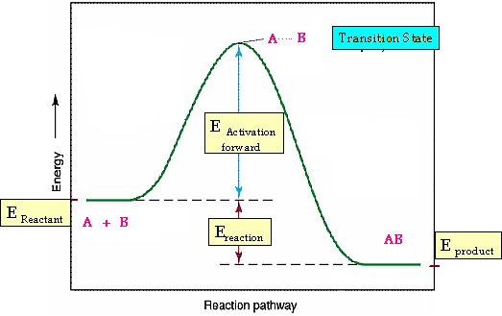
Some Basic Concepts
Thermodynamics and Kinetics
In a single elementary reaction, kinetic and thermodynamic are not coupled
to each other e.g. the more exergonic a reaction the faster it runs.
transition state
E_{a} forward
ΔG reactant
ΔG reaction
ΔG products
however, the ΔΔG may translate into a ΔΔG*, then thermodynamics impacts kinetics

Slide 21
Some Basic Concepts
Activation Energies
Empirical: Arrhenius-equation
k = A · exp(-E_{a}/RT)
Arrhenius-Energy of activation
A: pre-exponational factor
Transition state theory: Eyring- equation
k_{B} · T
k_{B} · T
k=
· exp(-ΔG≠ /RT) =
·exp(ΔS# /R) ·exp(- ΔH# /RT)
h
h
k_{B}: Boltzmann-constant, T: abs. temperature, h: Planck constant
k_{B}·T/h ≈ 10¹³ sec⁻¹ bei 25°C
ΔG# : free energy of activation
ΔH# : enthalpy of activation
ΔS# : entropy of activation

Slide 22
Mechanism and Rate Law
Example: Product formation via intermediate in equilibrium
k₁
k₃
A + B Z P
k₂
d[A] /dt = d[B]/dt = -k₁ · [A] ·[B] + k₂ ·[Z]
d[Z] /dt = k₁·[A]·[B] - k₂·[Z] - k₃·[Z]
d[P]/dt = -d[Z] /dt = k₃·[Z] = f([A], [B])
Rate equations:
Example: rapid prior equilibrium
K
k₃
k₁
[Z]
A + B Z P
K =
=
k₂
[A] · [B]
d[P]/dt = k₃ ·[Z] = k₃·K ·[A] ·[B]; k₃ · K = konst.

Slide 23
Mechanism and Rate Law
Example: Z is a short-lived intermediate
Principle of stationary: d[Z]/dt = 0
k₁
d[Z]/dt = 0 = k₁ · [A]·[B] - k₂·[Z] - k₃·[Z]
[Z] =
·[A]·[B]
k₂ + k₃
E
k₃·k₁
k₃·k₁
v = k₃ ·[Z] =
·[A]·[B];
= konst.
k₁
k₂
k₃
k₂ + k₃
k₂ + k₃
R : R‘
P : P‘
P + P‘
E
E
R + R‘
k₁
k₂
O
k₃
k₃
E
k₂
z
k₁
k₂
k₃
k₁
z
P
A + B
P
R : R‘
P : P‘
P + P‘
A + B
R
O
R + R‘
O

Slide 24
Mechanism and Structure
Geometry and Mechanism: k = p · Z · e^{-Ea/RT}
Steric factor p influences the respective geometric arrangements
of colliding molecules (cross section).
Influence of: Size and geometry of atoms, molecules and ions
Example: Perchlorate und Periodate are strong oxidants.
Periodates are "larger" and react much faster.
Example: H₂O₂ → H₂O + ¹/₂ O₂ I
    H₂S₂ → H₂S + S II
    I more exothermic than II, but II faster than I
    Geometry of molecules
        SF₄ hydrolyses very fast
        SF₆ hydrolyses very slow if ever

Slide 25
Mechanism and Structure
Orbital control
"least energy pathway" and the criteria of maximal overlap
s = 0
s < 0
s > 0
„Least energy pathway“ controlled by HOMO – LUMO interaction

Slide 26
Mechanism and Structure
- HOMO/LUMO-Interaction of molecules as criteria for reaction pathway
Interaction
Attractive
Repulsive
- Retention of orbital symmetry (Woodward-Hoffmann Rules)

Slide 27
Mechanism and Structure
Reactions of molecules with covalent bonds
Retention of orbital symmetry as reaction path criteria
(Woodward-Hoffmann Rules)
Example: H₂ + I₂ 2 HI
σ∗ I₂
a
a
σ * HI
σ ∗ H₂
a
s
σ I₂
s
a
σ HI
σ H₂
s
s
Symmetry forbidden
different reaction pathway

Slide 28
Mechanism and Structure
Example: CO + Cl₂ COCl₂
lp_{C}
lp_{o}
s
a
lp_{o}
s
s
σ Cl₂
s
s
σ C-Cl
π CO
a
a
Symmetry forbidden
radical reaction

Slide 29
Mechanism and Structure
Example: 2 N₂H₂ N₂ + N₂H₄
a
a
σ∗ NH
σ * NH
s
s
π∗ NN
s
s
π∗ NN
π NN
s
Symmetry allowed
di-imine is very unstable
s
π NN
a
σ NH
s
a
σ NH
s

Slide 30
Mechanism and Structure
Radical reactions Spin conservation rules
A + B AB
AB = product, intermediate or activated complex
Spin allowed, if obeying the Wigner und Witmer rules:
S_{A} + S_{B} S_{AB}
S_{A} + D_{B} D_{AB}
S_{A} + T_{B} T_{AB}
S_{A} + Q_{B} Q_{AB}
D_{A} + D_{B} S_{AB} oder T_{AB}
D_{A} + T_{B} D_{AB} oder Q_{AB}
D_{A} + Q_{B} T_{AB} oder Qi_{AB}
T_{A} + T_{B} S_{AB} oder T_{AB} oder Qi_{AB}
T_{A} + Q_{B} D_{AB} oder Q_{AB} oder Sx_{AB}
Q_{A} + Q_{B} S_{AB} oder T_{AB} oder Qi_{AB} oder Sp_{AB}
unpaired electrons
S = Singulett 0
D = Doublet 1
T = Triplet 2
Q = Quartet 3
Qi = Quintet 4
Sx = Sextet 5
Sp = Septet 6

Slide 31
Mechanism and Structure
Spin Multiplicity Matrix for radical reactions
M_{B} | M_{A}
 | 1 | 2 | 3 | 4 | 5 | 6 | 7 | 8
1 | 1 | 2 | 3 | 4 | 5 | 6 | 7 | 8
2 |  | 1,3 | 2,4 | 3,5 | 4,6 | 5,7 | 6,8 | 7,9
3 |  |  | 1,3,5 | 2,4,6 | 3,5,7 | 4,6,8 | 5,7,9 | 6,8,10
4 |  |  |  | 1,3,5,7 | 2,4,6,8 | 3,5,7,9 | 4,6,8,10 | 5,7,9,11
Multiplicities M_{A} und M_{B}: 2S+1
here M_{A} >= M_{B}
Maximum multiplicities for reactions M_{A} und M_{B} = M_{A} + M_{B} - 1
Minimum multiplicities for reactions M_{A} und M_{B} = M_{A} - M_{B} + 1
A. Maitland et al. J. Chem. Educ. 1983, 3, 202 und Refs.

Slide 32
Mechanism and Structure
Radical Reactions
„Spin forbidden“
Organic molecule + O₂ → Organic product
(S) (T) (S)
„Spin allowed“
RH + O₂ R• + HO₂• unfavored, R· endothermic
(S) (T) (D) (D)
R • + O₂ RO₂ • R· must be a reactant
(D) (T) (D)
RH + O₂ + HR R• + HOOH + R• unfavored, termoleculare reaction
(S) (T) (S) (D) (S) (D)

Slide 33
Mechanism and Structure
Radical reactions: how does nature "activate e.g. ³O₂ ?
by spin transfer to metal centres
+
S
S
+ 2H⁺ + 2e⁻
Hemocyanine acts as O₂ transporter and as O₂ activator
Similar reactivities are also found for Fe²⁺/³⁺ mono- or dinuclear enzymes

Slide 34
Exercises
Find the elementary steps in the following reactions
[RhCl(PPh₃)₃] + H₃C-I
[Rh(CH₃)ICl(PPh₃)₂]
2 [Co(CN)₅]³⁻ + Br₂
2 [CoBr(CN)₅]³⁻
fac-[Re(sol)₃(CO)₃]⁺ + ¹⁷OH₂
fac-[Re(sol)₃(CO)₂(C¹⁷O)]⁺ + OH₂
fac-[Re(sol)₃(CO)₃]⁺ + ¹³CO
fac-[Re(sol)₃(CO)₂(¹³CO)]⁺ + CO

Slide 35
2. Rate Laws and Mechanisms
2.1 Simple kinetic rate laws
1st order kinetic
A P
Reactions following a 1st order mechanism are rare (do you know one?)
These are generally intramolecular reactions
Important: To deduce a mechanism from kinetics, even complicated schemes
can be reduced to 1st (pseudo 1st) order rate laws
Take the reaction
Follows the rate law
dCo(CN)
dt
(k₁k₂[CN–]{Co})
1st order?
=
(k_{–1} + k₂[CN–])

Slide 36
2. Rate Laws and Mechanisms
2.1 Simple kinetic rate laws
1st order kinetic
A P
can easily be integrated
ln[A] = ln[A_{o}] - kt
-kt
ln2
k
or A(t) = A_{o}e
and
t_{1/2} =
half life time independent of A₀
graphical representation ln[A] vs. t is linear
slope gives k (lin reg)
variation of [A₀] over a broad range
should yield constant k

Slide 37
2. Rate Laws and Mechanisms
2.1 Simple kinetic rate laws
1st order kinetic
A P
can easily be integrated
ln[A] = ln[A_{o}] - kt
-kt
ln2
k
or A(t) = A_{o}e
and
t_{1/2} =
calculate k from each point [A]_{t} relative to
[A0], should yield a constant k, no trends
Kinetic pseudo 1. order
k₁ → k_{obs}

Slide 38
2. Rate Laws and Mechanisms
2.1 Simple kinetic rate laws
Let's look at a bimolecular, single step reaction
A + B P
v = k₁ [A] [B]
We choose [B]₀ >> [A]₀ so that [B](t) = [B]₀ = constant
v = k_{obs} [A]
1. Ordnung mit k_{obs} = k₁ [B]₀
graphical representation of k_{obs} vs [B]₀ gives k₁
pseudo 1st order reaction
(k₁k₂[CN–]{Co})
can also be considered as pseudo 1st order
but k_{obs} vs. [CN]₀ is not linear
dCo(CN)
dt
=
(k_{–1} + k₂[CN–])

Slide 39
2. Rate Laws and Mechanisms
2.1 Simple kinetic rate laws
Let's look at a bimolecular, single step reaction
A + B P
v = k₁ [A] [B]
2. Order Kinetics
1
2
d[A]
dt
A + A P *
= -k⋅[A]²
1
[A]_{t}
1
[A]₀
[A]_{t} = [A]₀ - 2⋅k [A]₀·t [A]_{t}
=
+ 2⋅k⋅t
graphic representation
[A]_{t} vs. t⋅[A]₀⋅[A]_{t} gives line with slope -2k
or
1
k[A]₀
[A]_{t}⁻¹ vs. t
t_{1/2} =
* Do you know examples for this type of reaction?

Slide 40
2. Rate Laws and Mechanisms
2.1 Simple kinetic rate laws
Let's look at a bimolecular, single step reaction
A + B P
v = k₁ [A] [B]
t_{1/2} =
1
k·[A]₀
depends on initial concentration
General reaction:
A + B P
1:1 Stöchiometrie
For [A]₀ = [B]₀, treatment as for [A] only since [A]_{t} = [B]_{t}
For slight excess of [A]₀ or [B]₀ over the other
Concentration dependencies:
+ [A]_{t}

Slide 41
2. Rate Laws and Mechanisms
2nd order rate laws
Concentration dependencies
+ [A]_{t}
rate law:
can be integrated:
[B]_{t} can be substituted by [A]_{t} and [A]₀
If [B]₀ >>> [A]₀, [B]_{t} = const. = [B]₀ and equation reduces to pseudo 1st law

Slide 42
2. Rate Laws and Mechanisms
Example: outer sphere electron transfer reaction
[Fe(OH₂)₆]³⁺ + [Np(OH₂)₉]³⁺ → [Fe(OH₂)₆]²⁺ + [Np(OH₂)₉]⁴⁺
Reaction is monitored by UV/vis spectroscopy
[Np³⁺]₀ = 1.53·10⁻⁴ M , [Fe³⁺]₀ = 2.24·10⁻⁴ M
Absorption for t∞ = 0.351
Zeit/ s: 0 2.5 3.0 4.0 5.0 7.0 10.0 15.0 20.0
Absorption*: 0.100 0.228 0.242 0.261 0.277 0.300 0.316 0.332 0.341
calculate the rate constant for -k [Np³⁺] [Fe³⁺] along different approaches
* absorption at 723 nm, Fe^{2+/3+} do not absorb at this wave length

Slide 43
2. Rate Laws and Mechanisms
2.2 Consecutive Reactions
k₁
k₂
A
B
P
typical scheme for radioactive decay in actinide elements
B can be a true intermediate which accumulates or a short lived intermediate
in chemistry: no step of reversibility
d[A]
dt
d[B]
dt
= k₁[A] – k₂[B]
d[C]
dt
= -k₂[B]
= -k₁[A]
[A] = [A]₀⋅e
-k₁⋅t
… and substitute in 2nd equation, integrate
dissolve 1st equation:

Slide 44
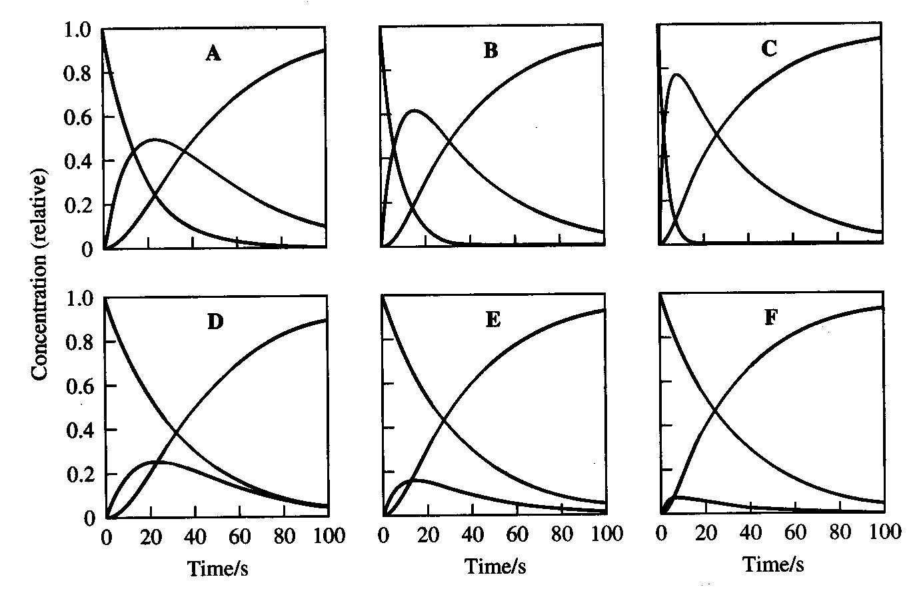
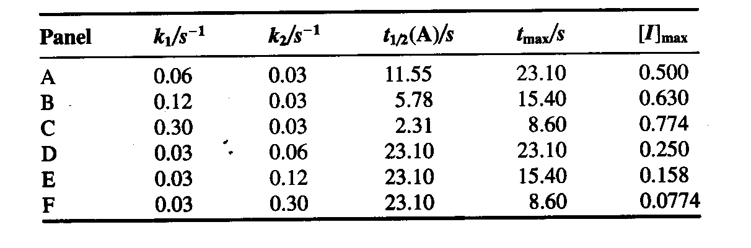
2. Rate Laws and Mechanisms
2.2 Consecutive Reactions
k₁
k₂
A
B
P
k₁exp(-k₂t)-k₂exp(-k₁t)
since [C] = [A]₀ – [B] – [A]
[C]_{t} =
(1 +
)⋅[A]₀
k₂-k₁
[B]_{t} will go through a maximum
biexponential function in k₁ and k₂
or non-linear least square fitting
How does a reaction profile looks like for this kind of reaction?

Slide 45
2. Rate Laws and Mechanisms
2.2 Consecutive Reactions with one reversible step
k₁
k₂
A + B
C
D
k₋₁
d[A]
dt
d[B]
dt
= -k₁[A][B] + k₋₁[C]
=
equations:
d[C]
dt
cannot be solved analytically
numerical integration
= k₁[A][B] - k₂[C]
d[D]
dt
= k₂[C]
k₁
k₋₁
assumption: if k₋₁>>k₂ then k₁[A][B] = k₋₁[C] and K=
therefore
d[D]
dt
= k₂[C] = k₂K⋅[A]⋅[B]
and k_{obs} = k₂⋅K
2nd order kinetics
This is also a simplified form of the pre-equilibria situation (see later)

Slide 46
2. Rate Laws and Mechanisms
2.2 Consecutive Reactions with one reversible step
k₁
k₂
simpler form
A
C
D
k₋₁
Rate laws:
d[A]
dt
= -k₁[A] + k₋₁[C]
d[C]
dt
= k₁[A] - k₋₁[C] + k₂[C]
d[D]
dt
= k₂[C]
Can be solved explicitly but does not make sense for chemical reactions
approximations
therefore
d[D]
dt
= k₂[C] = k₂K⋅[A]⋅[B]
and k_{obs} = k₂⋅K
2nd order kinetics

Slide 47
2. Rate Laws and Mechanisms
2.3 Reversible and concurrent reactions
k₊₁
Reversible reaction A P
k₋₁
at equilibrium
[A]₀ + [P]₀ = [A]_{e} + [P]_{e} = [A]_{t} + [P]_{t}
k₊₁ [A]_{e} = k₋₁ [P]_{e}
can be integrated after transformation
[A]_{t} = [A]_{e} + ([A]₀ - [A]_{e})(exp[-(k₁ + k₋₁)t])
⇒ ln([A]_{t} - [A]_{e}) vs. t gives slope k₁ + k₋₁

Slide 48
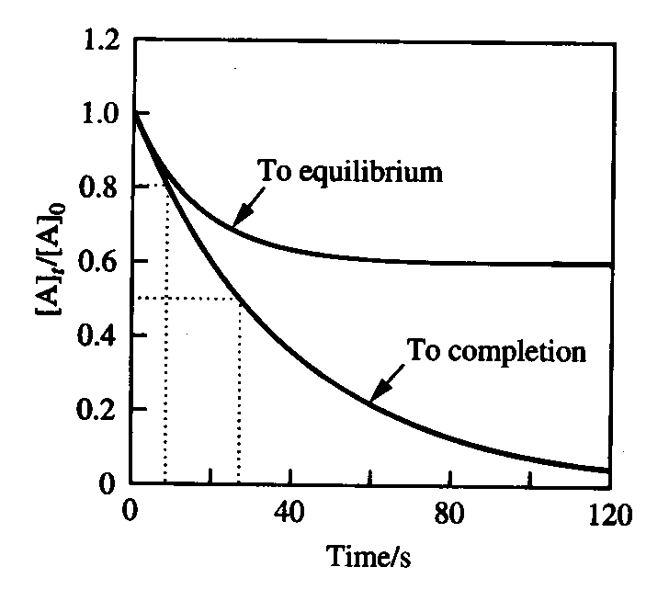
2. Rate Laws and Mechanisms
2.3 Reversible and concurrent reactions
k₊₁ + k₋₁ is the apparent and observed k_{e}
k_{e} = k₊₁ + k₋₁ oder
[A]_{t} decreases with k_{e} t_{½} = ln2/k_{e}
k_{e} can be calculated
If P is involved in a consecutive equilibrium,
t_{½} becomes ln2/k₁
or if k₋₁ << k₊₁, simple one step reaction

Slide 49
2. Rate Laws and Mechanisms
2.3 Reversible and concurrent reactions
k₊₁
more realistic:
A + B
P
k₋₁
such schemes reduce to the former if [B₀] >> [A₀]
p.m. ln([A]_{t} - [A]_{e}) vs. t gives slope k_{e} = k₁ + k₋₁
now "k₁" (=k_{obs1} becomes k₁[B₀]
which can be substituted to yield
k_{e}
k_{e}
k_{e}=k₁[B₀] + k₋₁
and k₁ =
k₋₁ =
[B₀] + K⁻¹
1 + K[B₀]

Slide 50
2. Rate Laws and Mechanisms
2.3 Reversible and concurrent reactions
k₊₁
more realistic:
A + B
P
k₋₁
k_{e}
k_{e}
k_{e}=k₁[B₀] + k₋₁
and k₁ =
k₋₁ =
[B₀] + K⁻¹
1 + K[B₀]
note: kinetic measurements allow the determination of equilibrium constants
k_{e}
k₁
k₋₁
[B₀]

Slide 51
2. Rate Laws and Mechanisms
2.3 Reversible and concurrent reactions
k₁
P₁
k₂
parallel reactions:
A
P₂
k₃
P₃
concurrent reactions:
A₁ + B
P₁
A₂ + B
P₂
may be a side reaction
product ratio P₁/P₂ = k₁/k₂ if A₁ and A₂ are in large excess over B
[A₁]₀
[A₁]₀-[P₁]_{f}
ln
k₁
k₂
if not the case:
=
f=final
[A₂]₀
[A₂]₀-[P₂]_{f}
ln

Slide 52
2. Rate Laws and Mechanisms
2.3 Reversible and concurrent reactions
concurrent reactions:
A₁ + B
P₁
A₂ + B
P₂
often, only one or the other product is observable analytically
B is limiting since not in excess, thus e.g. [P₁]_{f} = [B]₀ - [P₂]_{f}
[A₂]₀([B₀]-[P₂]_{f}
if we observe P₂ we know k₂
k₁= k₂⋅
[A₁]₀[P₂]_{f}
[A₁]₀
[A₁]₀-[P₁]_{f}
ln
k₁
k₂
if not the case:
=
[A₂]₀
[A₂]₀-[P₂]_{f}
ln

Slide 53
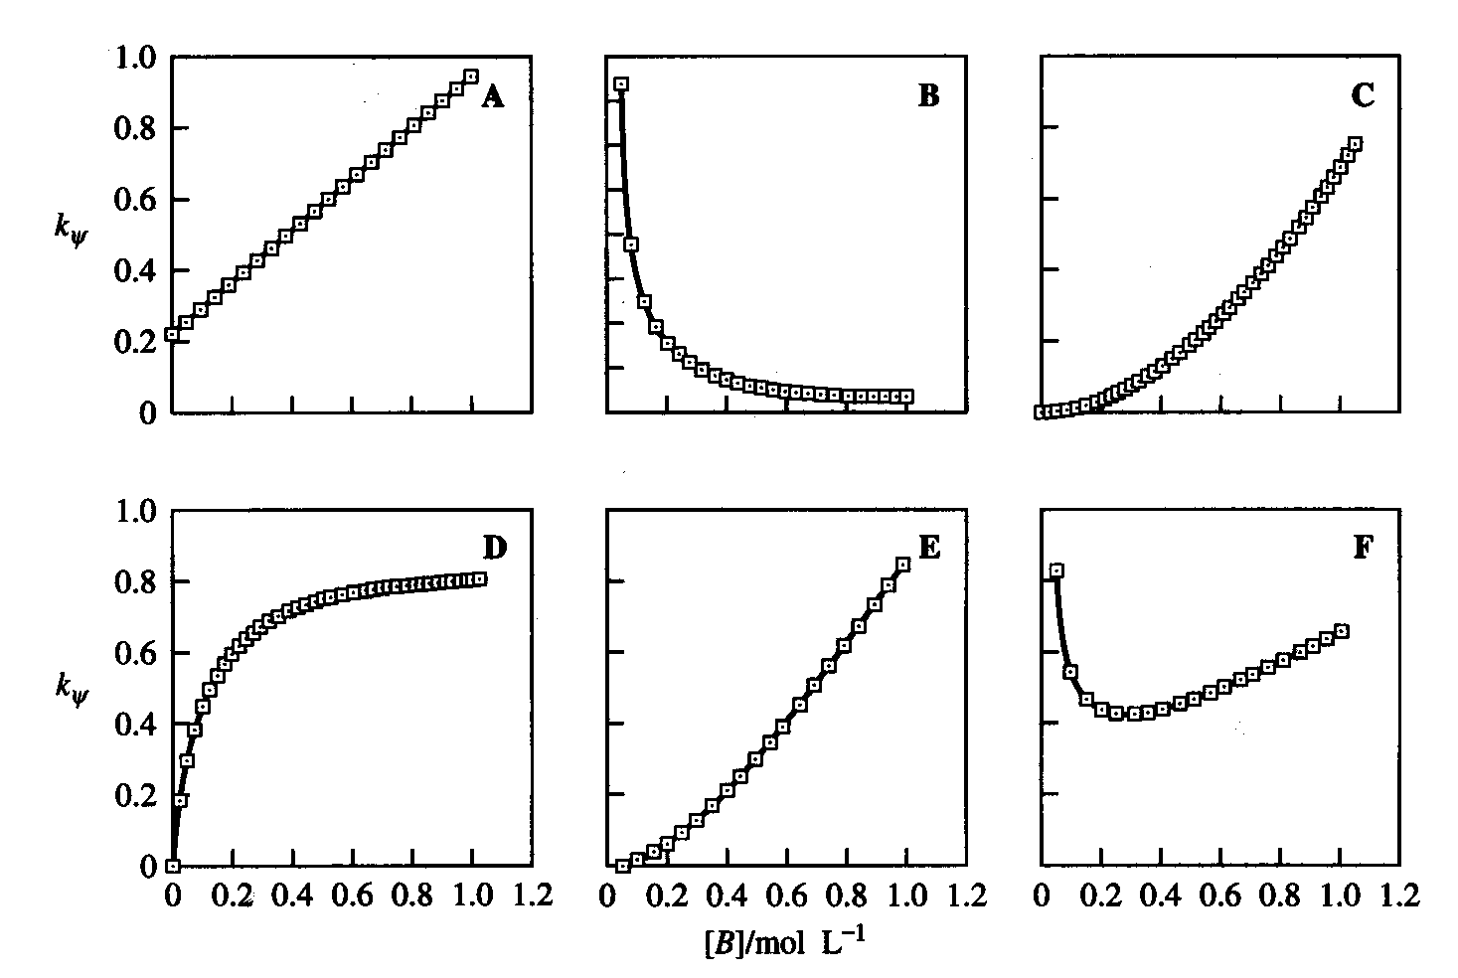
3. Overall Reaction and Reaction Rate
k_{obs} contains the mechanistic information
complicated mechanisms should be reduced to pseudo 1st order kinetics
e.g. for v = -k₁ [A] [B] chose [B]₀ >> [A]₀
k_{obs}
k_{obs} is then in the simplest case k₁ [B]₀
k₁=
[B]₀
graphical evaluation
line goes through origin
but: we often find non-linear behaviour
for kobs vs. [B]₀
k₁ + k₂[B] k₁ + k₂/[B] k₁[B] + k₂[B]²
possible dependencies
mechanism is more complex!
k₁[B]/(1 + k₂[B]) k₁[B]²/(1 + k₂[B]) k₁ + k₂[B] + k₃/[B]

Slide 54
3. Overall Reaction and Reaction Rate
Experimente
Bruttoreaktion
A + B = P
Modellierung
Kinetische Messungen
Erfahrung und Intuition
Übereinstimmung
Experimentelles
v-Gesetz
Vorschlag für Mechanismus
theoretisches v-Gesetz
Exp. Prüfung der
Modellaussagen
Prognosen über Zwischenprodukte,
Wirkung von Einflussgrössen, etc.
nein
Prognose erfüllt
ja
Modell, das die vorhandenen exp.
Befunde konsistent erklärt
eindeutig
Mechanismus Geschwindigkeitsgesetz
mehrdeutig

Slide 55
Overall Reaction and Reaction Rate
The overall reaction shows the number of participating particles
2 Fe²⁺ + Tl³⁺ 2 Fe³⁺ + Tl⁺
does not mean that v = k [Fe²⁺]² [Tl³⁺]
the rate law is proportional to concentrations but must be deduced experimentally
in fact:
v₁ = k [Fe²⁺] [Tl³⁺]
p.m. stoichiometry defines the time dependence of the particles
and, if no intermediates show up in significant concentrations

Slide 56
Overall Reaction and Reaction Rate
a mechanism is the sum of all elementary steps
reactions looking termolecular are often bimolecular
for instance this one
2 Fe²⁺ + Tl⁺ 2 Fe³⁺ + Tl³⁺
in fact, a reaction with two elementary steps
Fe³⁺ + Tl⁺ Fe²⁺ + Tl²⁺
Tl²⁺ + Fe³⁺ Fe²⁺ + Tl³⁺
how to deduce the mechanism, how to formulate the rate law ?
how to explain the reaction order = 1 in [Fe²⁺]

Slide 57
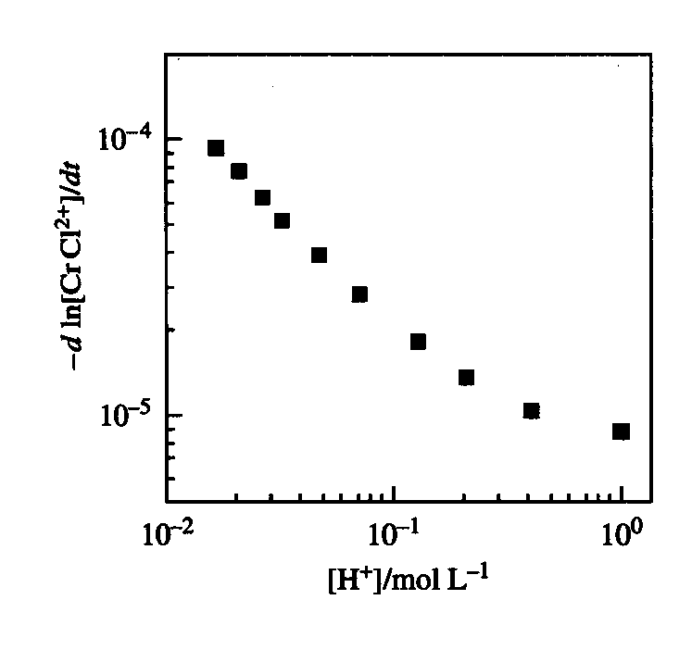
Overall Reaction and Reaction Rate
reaction mechanism often depend on particles which do not show up in the equation
[(H₂O)₅CrCl]²⁺ + H₂O [(H₂O)₅Cr(OH₂)]³⁺ + Cl⁻
v₁ = k₁ [(OH₂)₅CrCl][H₃O⁺]
k_{obs} =
k₁ +
k₂
the more alkaline, the faster, why?
[H⁺]

Slide 58
Overall Reaction and Reaction Rate
reaction mechanism often do not depend on particles which show up in the equation
[(NH₃)₅CoBr]²⁺ + X⁻ [(NH₃)₅CoX]²⁺ + Br⁻
X⁻ = Cl⁻, CN⁻, NCS⁻ etc.
v = k [(NH₃)₅CoBr]
composed of multi elementary steps
[(NH₃)₅CoBr]²⁺ [(NH₃)₅Co(OH₂)]³⁺ [(NH₃)₅CoX]²⁺
unpredictable based on the reaction equation
A
v = k_{obs}⋅[A][CH₃I]⋅[I⁻]

Slide 59
Overall Reaction and Reaction Rate
Parameters which influence the reaction rate
Concentration: at least one concentration will accelerate the reaction
Products: can accelerate or decelerate the reaction
Impurities: can have a (positive or negative) catalytic effect
pressure / temperature / radiation
Solvent: polarity, viscosity, donor-acceptor properties, electrolytes buffer etc.
Concentration dependencies
determine the rate if all other parameters are kept constant

Slide 60
Overall Reaction and Reaction Rate
3.1 Steady state approximation
consecutive two step reaction with one reversible step
k₁
k₂
A I P
k₋₁
this (simplified) reaction is often decisive in chemical processes
approximation: the intermediate does not change during the reaction
steady state:
[Int] is small but not 0

Slide 61
Overall Reaction and Reaction Rate
3.1 Steady state approximation
steady state:
or k₁[A] - k₋₁[Int] - k₂[Int] = 0
mit in steady state
[I]* can now be substituted in the rate law to yield
approximation! if
then
very small since k₋₁ + k₂ >> k₁

Slide 62
Overall Reaction and Reaction Rate
3.1 Steady state approximation
Reaction profiles for a steady state approximation
I
I
A
A
P
P

Slide 63
Overall Reaction and Reaction Rate
3.1 Steady state approximation
example:
S_{N1} type reaction, frequent in chemistry
in inorganic chemistry, this is called a D (Dissociation) type reaction
k₁
RX R⁺ + X⁻
k₋₁
k₂
R⁺ + Y⁻ RY
rate law:
bei altering [X] or [Y], we can differentiate cases for k₁, k₋₁, k₂

Slide 64
Overall Reaction and Reaction Rate
3.1 Steady state approximation
different cases
1. k₂ >> k₋₁
k₁
k₂
A I P
k₋₁
k_{obs} = k₁
k₁ becomes rate determining
therefore
schnell
if k₂ is slow in comparison to k₋₁, we cannot use the steady state approximation
but a consecutive scheme with irreversible steps
reaction (k₁ + k₋₁)⁻¹
reaction k₂⁻¹
1
is a measure for the life time of the reaction
k_{obs}

Slide 65
Overall Reaction and Reaction Rate
3.1 Steady state approximation
different cases
2. k₂ << k₋₁
k₁
k₂
A I P
k₋₁
k₁⋅k₂
k₋₁
k_{obs} =
= K⋅k₂
k₂ becomes rate determining
this situation is also called rapid pre-equilibrium
The first equilibrium is achieved at all time points during the reaction
does not mean that k₁ is necessarily fast, it can be slow either but much faster than k₂

Slide 66
Overall Reaction and Reaction Rate
3.1 Steady state approximation
2 Fe³⁺ + Tl⁺ 2 Fe²⁺ + Tl³⁺
in fact, a reaction with two elementary steps
Fe³⁺ + Tl⁺ Fe²⁺ + Tl²⁺
k₁
k₋₁
k₂
Tl²⁺ + Fe³⁺ Fe²⁺ + Tl³⁺
the correct rate law under steady state conditions is:
dTl³⁺
dt
k₁⋅k₂⋅[Fe³⁺]²⋅[Tl³⁺]
=
k₋₁⋅[Fe²⁺]+k₂⋅[Fe³⁺]
since we find v= k⋅[Fe³⁺]⋅[Tl³⁺]
we conclude that the second step is very fast i.e. k₂ >> k₋₁
and k = k₁ is the rate determining step
we don't "see" the steps beyond the rate determining step !!

Slide 67
Overall Reaction and Reaction Rate
3.1 Steady state approximation
substitution mechanisms
A Associative
or D Dissociative
I intermediates and not transition states, distinguishable ?

Slide 68
Overall Reaction and Reaction Rate
3.1 Steady state approximation
if k₋₁ [Fe³⁺] << k₂ [Fe²⁺] then
if k₋₁ [Fe³⁺] >> k₂ [Fe²⁺] then
Darstellung als Reaktionsprofil
reaction profiles for two cases of rate constants
k₁
k₂
A I P
k₋₁
k₋₂
a: k₁=1; k₋₁=10⁻⁸; k₂=10¹⁰; k₋₂=10⁻⁴ s⁻¹
b: k₁=1; k₋₁=10¹⁰; k₂=10⁸; k₋₂=10⁻⁸ s⁻¹

Slide 69
Overall Reaction and Reaction Rate
3.1 Steady state approximation
which is now the rate determining step?
It is not necessarily the one with the highest transition state
introduce a control factor for each elementary step
k₁
k₂
A I P
k₋₁
an excess rate factor is introduced for each step
und
if a step produces a lot of excess, it is not rate determining

Slide 70
Overall Reaction and Reaction Rate
3.1 Steady state approximation
which is now the rate determining step?
if a step produces a lot of excess, it is not rate determining
und
forward rate for the 1st step
- overall rate: if zero or small, then rate determining
Rate Constants, s⁻¹
k₁ k₋₁ k₂ Case RCS
1 10⁻² 10² k₂ >>k₁ >>k₋₁ 1
10⁴ 10⁶ 10² k₋₁ >>k₁ >>k₂ 2
10² 10⁶ 10⁴ k₋₁ >>k₂ >>k₁ 2
1 10² 10⁴ k₂ >>k₋₁ >>k₁ 1
10² 1 10⁻² k₁ >>k₋₁ >>k₂ 2
1 10⁻⁴ 10⁻² k₁ >>k₂ >>k₋₁ 2
1 10² 10² k₂ = k₋₁ >>k₁ None
2 1 1 k₁ > k₋₁ = k₂ None

Slide 71
Overall Reaction and Reaction Rate
Example: Typical reaction under steady state conditions
Photolytic cleavage of CO in the presence of a coordinating solvent
A
I
P
Since A and P are 18 e⁻ species, "I" should be very reactive and only present in minute concentrations
accordingly:
see A.A. Bengali et al. Organometallics, 2003, 22, 5436

Slide 72
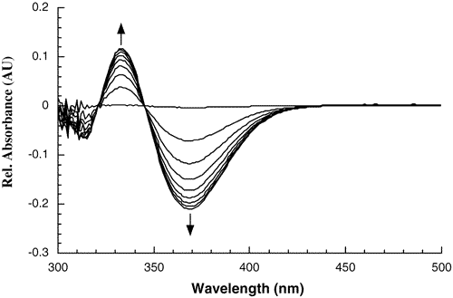
Overall Reaction and Reaction Rate
The product formation is followed by UV/vis spectroscopy
[CH₃CN] and [THF] are constant and >> [Re]
The equation can be modified to account for the solvent/ligand ratio
und

Slide 73
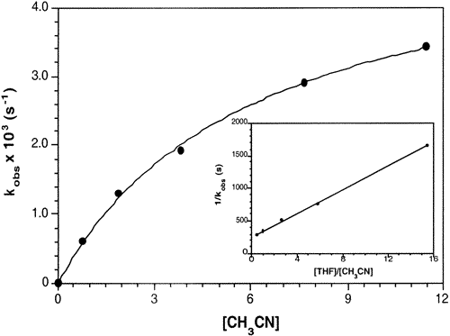
Overall Reaction and Reaction Rate
The graphical relationship k_{obs} vs. [CH₃CN] allows the calculation of k₁ und k* with the least square method.
Calculated rate constants k₁ [sec⁻¹]
Cp*[Re]: 9.24 ± 0.5
Tp*[Re]: 2.85 ± 0.13
Tp[Re]: 0.29 ± 0.01
ΔH≠ = 24 ± 0.9 kJ/mol
ΔS≠ = 9.2 ± 2.7 e.u.
Interpretation:
k_{obs} increases with [ACCN], but becomes constant for large [ACCN]
k₁ becomes rate determining

Slide 74
Overall Reaction and Reaction Rate
3.2 The prior equilibrium
an approximation often found in inorganic and pH dependent reactions
again a dependence of the different k's
if k₁ and or k₋₁ >>> k₂, we consider the first step as an equilibrium
we assume that the equilibrium is rapidly established and
maintained over the whole reaction
k₁
k₂
A B P
A or B may be the reactive species
k₋₁
then:
für [k₊₁ + k₋₁] >> k₂
important: [I]_{t} is not necessarily small and

Slide 75
Overall Reaction and Reaction Rate
3.2 The prior equilibrium
k₁⋅k₂
k₋₁
Dependencies:
k_{obs} =
= K⋅k₂
ergibt:
mit k_{pe} =
substituted and integrated:
if we consider the equilibria and the rate constants, we can write
is frequently found in ligand exchange reactions

Slide 76
Overall Reaction and Reaction Rate
3.2 The prior equilibrium
Dissociative and associative complex formation reactions
Complexation / decomplexation
Ion Pair formations,
charge transfer complex formations
Complex formation in a prior-equilibrium situation
K_{L}
k₂
A + L AL
P
dP
dt
= k₂[AL]
we consider the distribution coefficients as a function of K_{L}

Slide 77
Overall Reaction and Reaction Rate
3.2 The prior equilibrium
K_{L}
k₂
A + L AL
P
[AL]
[AL] + [A]
[AL]
[A]⋅[L]
[AL]
[K]⋅[L]
K·[L]
f_{AL} =
K_{L} =
[A] =
and
f_{AL} =
1+K·[L]
[AL]_{t} = f_{AL}([A]+[AL]) = f_{AL}[A]_{tot} = f_{AL}([A₀]-[P]_{t})
dP
dt
k₂⋅K⋅[L]⋅([A₀]-[P]_{t})
= k₂[AL]
=
1+K·[L]
if [L] is constant, the distribution coefficient f_{AL} and f_{A} is constant over the reaction
if we keep [L] constant and follow [P] we can get K and k₂
K: a thermodynamic parameter from a kinetic measurement !

Slide 78
Overall Reaction and Reaction Rate
3.2 The prior equilibrium
K_{L}
k₂
A + L AL
P
[A]
1
K·[L]
f_{A} =
=
resp.
f_{AL} =
[A]_{T}
1+K·[L]
1+K·[L]
the same principle can be followed if A is the reactive compound
example:
[Co(NH₃)₅(OH₂)]³⁺ + [SO₄]²⁻ [Co(NH₃) ₅(SO₄)]⁺ + H₂O
kinetic observations
reaction is pseudo first order at constant [SO₄]²⁻ concentration >> [Co]
reaction rate remains constant at high [SO₄]²⁻ concentration

Slide 79
Overall Reaction and Reaction Rate
3.2 The prior equilibrium
example:
[Co(NH₃)₅(OH₂)]³⁺ + [SO₄]²⁻ [Co(NH₃) ₅(SO₄)]⁺ + H₂O
rate constant:
looks like a D mechanism (or S_{N1} if you wish)
k₁
[Co(NH₃)₅H₂O]³⁺ {Co(NH₃)₅}³⁺ + H₂O
k₋₁
k₂
{Co(NH₃)₅}³⁺ + [SO₄]²⁻ [Co(NH₃)₅(SO₄)]⁺
k becomes and

Slide 80
Overall Reaction and Reaction Rate
3.2 The prior equilibrium
example:
[Co(NH₃)₅(OH₂)]³⁺ + [SO₄]²⁻ [Co(NH₃) ₅(SO₄)]⁺ + H₂O
k becomes and
the plateau correspond to k₁ which is then rate determining
this is a typical D mechanism (Langford-Gray)
or
K_{IP}
[Co(NH₃) ₅(H₂O)]³⁺ + SO₄²⁻ {Co(NH₃)₅(H₂O)}{ SO₄}
k₃
{Co(NH₃)₅(H₂O)}{ SO₄} [Co(NH₃) ₅(SO₄)]⁺
then, rate constant:
k₃ is now rate limiting (plateau)

Slide 81
Overall Reaction and Reaction Rate
3.2 The prior equilibrium
Typical reaction scheme for substation reactions (see also later)
K
A + L AL
B
B
k_{A}
k_{AL}
AB
[A]
1
[AL]
K·[L]
f_{A} =
=
f_{AL} =
=
[A]_{tot}
1+K·[A]
[A]_{tot}
1+K·[L]
reaction goes directly with k_{a} or with k_{AL} via a coupled intermediate (solvent complex)
d[AB]
k_{a}·[A]·[B] + k_{AL}[AL]·[B]
=
d[t]
[A] and [AL] can be expressed with f_{A} and f_{AL}

Slide 82
Overall Reaction and Reaction Rate
3.2 The prior equilibrium
Typical reaction scheme for substation reactions (see also later)
K
A + L AL
B
B
k_{A}
k_{AL}
AB
d[AB]
k_{a}·[A]·[B] + k_{AL}[AL]·[B]
=
d[t]
1. case: 1 >> K[L] then
(k_{A}+k_{AL}⋅K⋅[L])⋅[A]_{tot}⋅[B]
(AL very small)
2. case: equilibrium but only AL reactive
3. case: ….

Slide 83
Overall Reaction and Reaction Rate
Interesting example at the end: an isomerization
we observe that isomerization becomes slower upon the addition of excess "L"
rate law:
generally, isomerisation's become faster upon addition of one of the components
which mechanism explains this rate law?

Slide 84
Practical kinetic example: The Monsanto Acetic Acid Process
Overall Reaction and Reaction Rate
The synthesis of acetic acid from methanol is probably the most important
industrial process in homogenous catalysis
worldwide requirements are about 5.5 10⁶ t/a
Monsanto process invented 1966, before
oxidation of ethanol
oxidation of acetaldehyde
naphta oxidation
Carbonylation of methanol (Co-catalyst)
Carbonylation of methanol (Rh-catalyst)
[cat]
H₃COH + CO H₃CCOOH

Slide 85
Practical kinetic example: The Monsanto Acetic Acid Process
Overall Reaction and Reaction Rate
Comparison of the processes
selectivity T/°C p/atm
Naphta oxidation BP 65-70 185 48
MeOH / CO (Co cat) 90 230 600
MeOH / CO (Rh cat) 99 150-200 30-60
MeOH / MeOAc carbonylation (Rh cat) high 150-200 30-50
- CH₃COI
+ CH₃-I
catalytic cycle:
H₂O
+ CO
6 (!) reactions are interlinked to form one closed working catalytic system

Slide 86
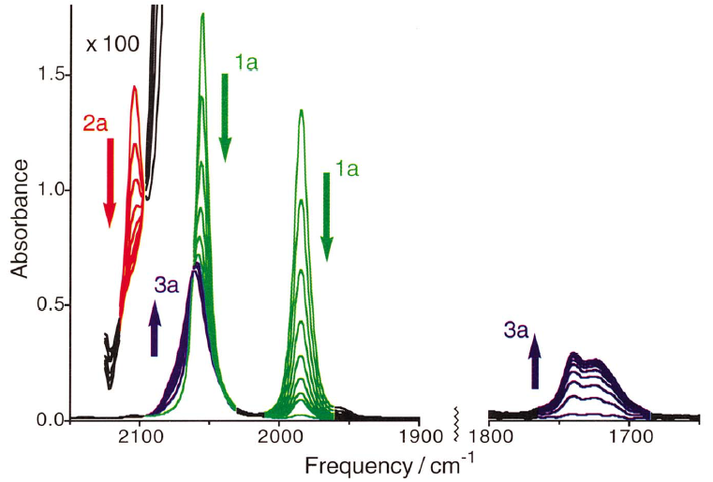
Practical kinetic example: The Monsanto Acetic Acid Process
Overall Reaction and Reaction Rate
Many studies focused on the rds of the cycle, namely
[RhI₂(CO)₂]⁻ + H₃C-I {RhI₃(CH₃)(CO)₂}⁻
1a
2a
polar solvents and addition of I⁻ accelerate the reaction
{RhI₃(CH₃)(CO)₂}⁻ (2a) difficult to detect spectroscopically
The next step, CO insertion, is fast
{RhI₃(CH₃)(CO)₂}⁻ [RhI₃(CO-CH₃)]⁻
2a
3a
very careful analysis of the i.r. spectra
2a and 3a become „visible“

Slide 87
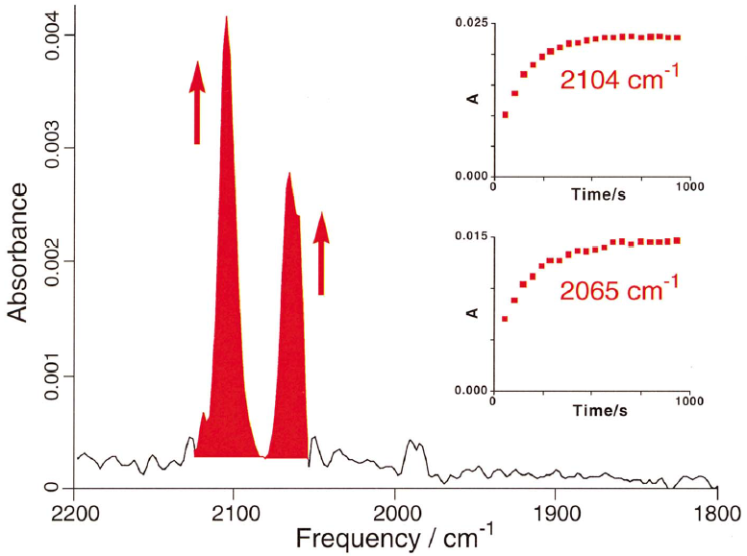
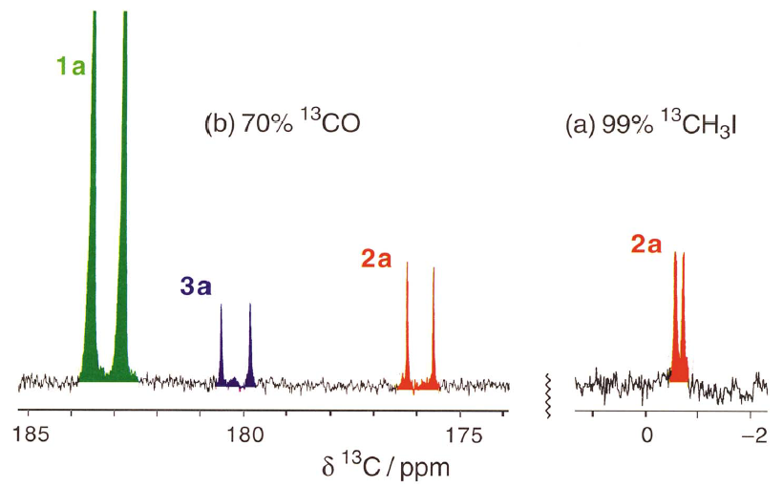
Overall Reaction and Reaction Rate
: increases and decreases with 1a
¹H and ¹³C NMR in deep cold solution of CH₃-I confirm the finding from i.r.
i.r. pattern discloses a fac,cis-dicarbonyl structure
The detection of 2a allows for determination of the individual steps

Slide 88
Practical kinetic example: The Monsanto Acetic Acid Process
Overall Reaction and Reaction Rate
k₁
k₂
[Rh(CO)₂I₂]⁻ + MeI
[MeRh(CO)₂I₃]
[(MeCO)Rh(CO)I₃
k₋₁
k₋₂
1a
2a
3a
rate constant:
k₁⋅k₂⋅[MeI]
k₁+ k₂
[2a]
[1a]
k₁⋅[MeI]
[1a]
[2a]
ratio of concentrations:
=
k₂ = k_{obs}⋅
k₁+ k₂
[1a]
can be estimated from i.r. intensities
which allows for the determination of k₂
[2a]
heating in the presence of exc. H₃C-I
allows for the determination of k₋₂
label exchanges between COCH₃ and CO
can be isolated

Slide 89
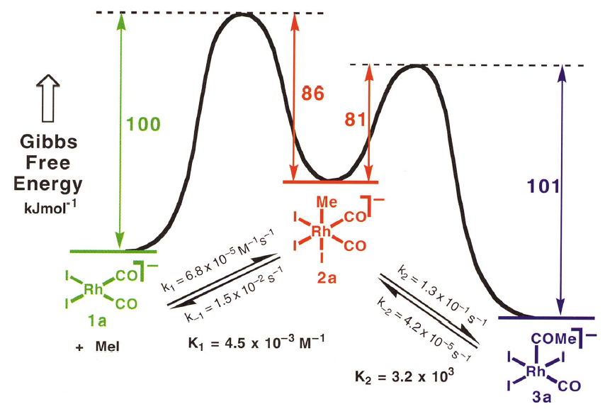
Practical kinetic example: The Monsanto Acetic Acid Process
Overall Reaction and Reaction Rate
from these experiments, a complete set of data could be deduced

Slide 90
Practical kinetic example: The Monsanto Acetic Acid Process
Overall Reaction and Reaction Rate
what about the remaining processes leading to acetic acid ?
+ CO
red. elim.
- H₃C-COI
3a is immediatly trapped by CO
4a eliminates H₃C-COI rather slowly (t_{1/2} = 12h at r.t.
difficulty to measure accurate kinetics (due to traces of water)
[Rh(CO)₂I₂]⁻ + 2HI
[Rh(CO)₂I₄]⁻
+ H₂
direct attack
+
red. elim.
+
amine attack

Slide 91
Practical kinetic example: The Monsanto Acetic Acid Process
Overall Reaction and Reaction Rate
further reactions: conversion of other alkyl-iodides to acids
acid
acid
HI / C₂H₄
acid
other alkenes can be used by substituting ethene
isomerization of alkenes or conversion to acids

Slide 92
Overall Reaction and Reaction Rate
3.3 Enzyme catalysed reactions and catalysis
a catalyst does not necessarily reduce E_{a}
but a catalyst induces a different reaction pathway, profile
a catalyst exists at least in two different forms
as free catalyst and ..
.. in interaction with substrate(s)
a catalyst circulates between inactive and active form
a good catalyst is present in very low concentration and ..
.. intermediates are not observable
if [S] >>> [cat], the reaction is 0th order in [cat] since it is fully active (saturation)

Slide 93
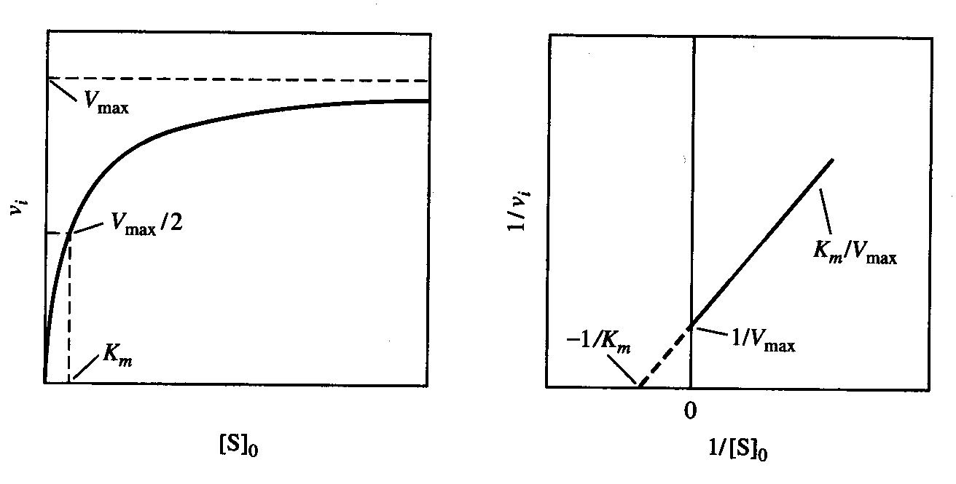
Overall Reaction and Reaction Rate
3.3 Enzyme catalysed reactions and catalysis
enzymes: concentration vs. rate of an enzyme
at low [S], reaction is 1st order in [S]: Michaelis Menten Kinetics
M-M Gleichung
K_{m}: [S] at which v =v_{max}/2, i.e. the smaller K_{m} the more efficient the catalyst (enzyme)
K_{m} is called M-M constant [dim=M]
see K.A. Johnson et al. Biochemistry, 2011, 50, 8264

Slide 94
Overall Reaction and Reaction Rate
3.3 Enzyme catalysed reactions and catalysis
1
v_{i}
1
v_{max}
K_{m}
linearization:
=
+
v_{max}[S₀]
v_{i} = initial rate as a function of [S₀]
allows now calculation of v_{max} and K_{m}
how to get rate constants from these numbers, mechanism behind?
k₁
k₂
E + S {ES} P + E
k₋₁
known scheme but this one is catalytic!
initial rat v_{i}=
k₂⋅{ES}

Slide 95
Overall Reaction and Reaction Rate
3.3 Enzyme catalysed reactions and catalysis
k₁
k₂
E + S {ES} P + E
k₋₁
steady state approximation:
catalytic condition: mit [E] = [E]₀ – [ES] = constant
[E₀]⋅[S₀]
k₂⋅[E₀]⋅[S₀]
dP
dt
[ES]_{ss} =
gives an initial rate
v_{i} =
=
k₋₁+ k₂
k₋₁+ k₂
+ [S₀]
+ [S₀]
k₁
k₁

Slide 96
Overall Reaction and Reaction Rate
3.3 Enzyme catalysed reactions and catalysis
k₂⋅[E₀]⋅[S₀]
v_{i} =
k₋₁+ k₂
+ [S₀]
k₁
comparison with M-M equation shows
v_{max} = k₂[E]₀
and
k₂ is also assigned as k_{cat}
the system is reminiscent to chemical reaction with
the difference that a catalyst is not used up!

Slide 97
Overall Reaction and Reaction Rate
3.3 Enzyme catalysed reactions and catalysis
Example: Hydrolysis of phenyl-acetate by acetyl-cholin esterase
the following v_{i}'s have been determined
[PhOAc], 10⁻⁴ M: 22.5 16.3 12.6 9.73 8.45 7.18 6.21 5.55
v_{i}, ·10⁻⁷ l·mol⁻¹s⁻¹: 7.24 6.35 5.32 4.61 4.53 4.02 3.38 3.26
calculate K_{m} and k_{cat} !

Slide 98
Overall Reaction and Reaction Rate
3.3 Enzyme catalysed reactions and catalysis
in chemical catalysis: catalysis happens generally with two (or more) compounds
fast
k₁ / k₋₁
activated
k₂
cat
S₁ + S₂ P
apply the steady state approach as in M-M kinetics
k₁⋅[cat]⋅[S₁]
[catS₁]_{ss} =
[cat]₀ = [cat] + [catS₁]
k₋₁+ k₂[S₂]

Slide 99
Overall Reaction and Reaction Rate
3.3 Enzyme catalysed reactions and catalysis
in chemical catalysis: catalysis happens generally with two (or more) compounds
fast
k₁ / k₋₁
activated
k₂
cat
S₁ + S₂ P
k₂⋅[E₀]⋅[S₁][S₂]
k₋₁
replacement etc. yields:
v_{i} =
k₂[S₂]
k₋₁
k₂[S₂]
k₁
+
k₁
= K'_{m}
+
k₁
+ [S₁]
k₁

Slide 100
Overall Reaction and Reaction Rate
3.3 Enzyme catalysed reactions and catalysis
in chemical catalysis: catalysis happens generally with two (or more) compounds
cat
S₁ + S₂ P
k₂⋅[E₀]⋅[S₁][S₂]
k₋₁
replacement etc. yields:
v_{i} =
k₂[S₂]
k₋₁
k₂[S₂]
k₁
+
k₁
= K'_{m}
+
k₁
+ [S₁]
k₁
initial rate approach (S₁ and S₂ constant) allows determining k₂
K'_{m} is now not constant but S₂ dependent
determination of K'_{m} as a function of S₂ allows determination of k₁ and k₋₁
all kinetic parameters are know!!
what if S₂ enters first, distinguishable?

Slide 101
Overall Reaction and Reaction Rate
3.4 Competitive Inhibitors
Compounds may inhibit the catalyst: Important tool in pharmaceutical development
k₁
k₂
E + S {ES} P + E
k₋₁
E + I EI
branched reaction, additional equilibrium
k_{I}
extended mass balance:
[E] = [E]₀ – [ES] – [EI]
v_{i} = initial rate
k₂⋅[E₀]⋅[S₀]
v_{i} =
[I]
K_{I}
K_{m}⋅
1 +
+ [S₀]
alteration of [I] gives K_{I}, how is that done?
systematic alteration of catalyst allows determination of electronic / steric influence

Slide 102
Overall Reaction and Reaction Rate
graphical evaluation in the steady state (and pe) schemes
example:
additional iodide accelerates the reaction
hypothesis 1:

Slide 103
Overall Reaction and Reaction Rate
graphical evaluation in the steady state (and pe) schemes
example:
additional iodide accelerates the reaction
hypothesis 2:
which one is correct, can they be distinguished ?

Slide 104
Overall Reaction and Reaction Rate
graphical evaluation in the steady state (and pe) schemes
"magic" formula in a steady state reaction scheme
Σ
all reactions producing [intermediate]
[intermediate]_{ss}
=
Σ
all pseudo 1st order reactions consuming [intermediate]
graphical analysis often by Lineweaver-Burk plots
many reaction rates in these schemes
go to saturation
under pseudo 1st order conditions

Slide 105
4. Deduction of Mechanisms
The path from rate laws to mechanisms is not routine (see p55)
experimental results lead to concentration dependencies
this leads to a reaction scheme which must coincide with the rate law
experiments must be design which exclude equal possibilities
concentration dependencies allow deduction of intermediates
example:
TI³⁺ + Hg₂²⁺ TI⁺ + 2Hg²⁺
[Tl³⁺][Hg₂²⁺]
dependencies:
k⋅
[Hg²⁺]
intermediate for ss:
[TI]³⁺ + [Hg₂²⁺] - [Hg²⁺] oder [TIHg³⁺]
Mechanism ?

Slide 106
4. Deduction of Mechanisms
example:
2[Mn^{III}(Mb)] + [S₂O₄]²⁻ 2[Mn^{II}(Mb)] + 2SO₂
dependency:
[S₂O₄²⁻]^{1/2}
intermediate:
[Mn(Mb)(SO₂)]
cleavage of S₂O₄²⁻
rate determining step: reaction of [SO₂]^{•-} with [Mn^{III}(Mb)]
positive terms in rate law: forward reaction steps
negative terms: reverse steps
3I⁻ + H₂O₂ + 2H⁺ I₃⁻ + 2H₂O
v = k₁[I⁻][H₂O₂] + k₂[I⁻][H₂O₂][H⁺]
two parallel reaction path with [(H₂O₂)(I⁻)]≠ und [(H₃O₂⁺)(I⁻)]≠

Slide 107
4. Deduction of Mechanisms
k₁
Example: branched reaction
RX R⁺ + X⁻
k₋₁
The rate law shows what happens in the rate determining step
The S_{N2} comprises shows reversibility
k₁
RX + Y⁻ RY + X⁻
k₋₁
v = k₁[RX][Y⁻] - k₋₁[RY][X⁻]
thus, a negative term arises
How does the S_{N2} rate law looks for silicon ?

Slide 108
4. Deduction of Mechanisms
Example: The reaction of Cr²⁺ with Fe³⁺ in hydrochloric acid
1st term: direct electron transfer reaction between Cr²⁺ and Fe³⁺, but pH dependent
2nd term: chloride mediated reaction but no pH dependency
The mechanism of the 2nd term is not unambiguously clear since
K_{FeCl}
Fe³⁺ + Cl⁻ [FeCl]²⁺
k₁
[FeCl]²⁺ + Cr²⁺ Fe²⁺ + [CrCl]²⁺
or
rate laws ?
how to differentiate ?
K_{FeCl}
Cr²⁺ + Cl⁻ [CrCl]⁺
k₂
[CrCl]⁺ + Fe³⁺ Fe²⁺ + [CrCl]²⁺

Slide 109
Deduction of Mechanisms
4.1 pH dependencies
Many reactions are pH dependent, although [H⁺] or [OH⁻] do not show up in the equation
only protonated or deprotonated form are active (see previous page)
K_{a}
simple scheme:
[AH⁺] A + H⁺
k₁
[AH⁺] P
here, only the protonated form is active
the amount of active species is defined by the pK_{a}
We think in distribution coefficients as in the case of complex formation
buffers !!
if [H⁺] is large, f_{HA} = 1 and everything is present as HA

Slide 110
Deduction of Mechanisms
4.1 pH dependencies
"HA" active
deprotonated form "A" is active:
d[P]
respective rate law:
= k₁[HA⁺]
= k₁·[HA]_{T}*·f_{HA}
for HA active
dt
gives for k_{obs} in the simplest case
[H⁺] = konst.
reaction pseudo 1st order if we can follow A or HA
k₁ und K_{a} can be determined experimentally
* [A]_{T} = total concentration of particles with A (including HA) at time t

Slide 111
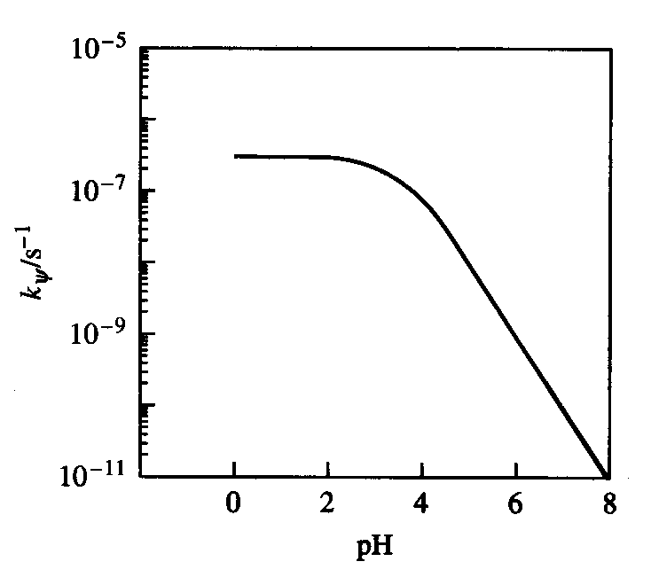
Deduction of Mechanisms
4.1 pH dependencies
if only HA is active
how does the curve looks like if only "A" is active ?
determination of pK_{a} ?
rate law if the conjugated base is the active form
K_{a}
k₂
[AH⁺] H⁺ + A
A + B P
then

Slide 112
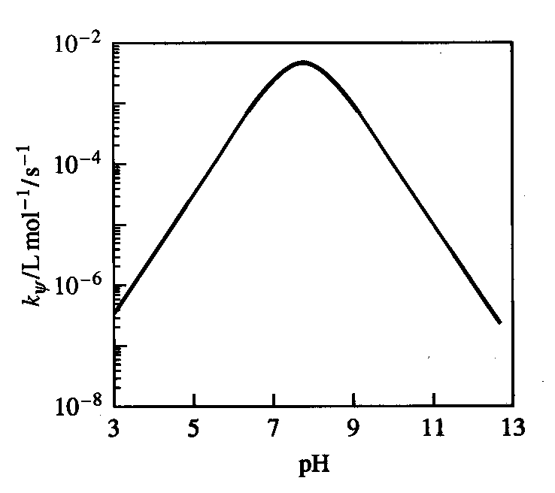
Deduction of Mechanisms
4.1 pH dependencies
if both "A" and "HA" are active as frequently found in real systems
pH vs. k_{obs} gives a curve with a maximum
example: decomposition of perbenzoic acid
2 C₆H₅CO₃H
2 C₆H₅CO₂H + O₂
k₁
[C₆H₅CO₃]- + C₆H₅CO₃H
P
With [C] = [HA] + [A] we find
The reaction is 2nd order and implies a mechanism with "A" and "HA"

Slide 113
Deduction of Mechanisms
nice example from organometallic chemistry for mechanism deduction
Co₂(CO)₈ + Ph₂C₂
[Co₂(CO)₆(Ph₂C₂)] + 2 CO
these are 18 e⁻ species, associative mechanism is unlikely
k₁
Path 1:
Co₂(CO)₈
[Co₂(CO)₇ + CO
k₋₁
k₂
[Co₂(CO)₇] + Ph₂C₂
[Co₂(CO)₆(Ph₂C₂)] + CO
Path 2:
k₁
[Co₂(CO)₈] + Ph₂C₂
[Co₂(CO)₇(Ph₂C₂)] + CO
k₋₁
k₂
[Co₂(CO)₇(Ph₂C₂)]
[Co₂(CO)₆(Ph₂C₂)] + CO
can we kinetically differentiate the two possibilities?
rate laws ?

Slide 114
Deduction of Mechanisms
k₁
Path 1:
Co₂(CO)₈
[Co₂(CO)₇ + CO
k₋₁
k₂
[Co₂(CO)₇] + Ph₂C₂
[Co₂(CO)₆(Ph₂C₂)] + CO
Path 2:
k₁
[Co₂(CO)₈] + Ph₂C₂
[Co₂(CO)₇(Ph₂C₂)] + CO
k₋₁
k₂
[Co₂(CO)₇(Ph₂C₂)]
[Co₂(CO)₆(Ph₂C₂)] + CO
experimental observations:

